Slide 1
Adversarial Framing for Image and Video Classification

Slide 2
Background
In general, such attacks deteriorate the quality of the input by either slightly modifying most of its pixels, or by occluding it with a patch

Slide 3
Goal
Keeping the whole content unchanged
Simply add a thin border around the original input
Untargeted attacks
Targeted attacks

Slide 4
Method
For fixed-size images and videos:
1.Every example is surrounded with the same framing
2.The classification loss is backpropagated
3.The framing is modified using its gradients to maximize the loss.
(Consider a white-box setting)

Slide 5
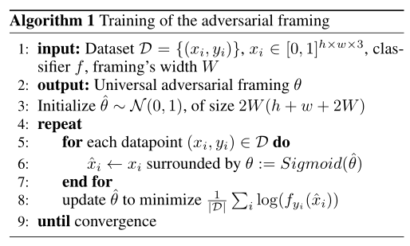
Algorithm

Slide 6
untargeted attacks
Goal:Train the AF adversarial framework to make the classifier misclassify
Method:Backpropagation for the frame gradient direction

Slide 7
untargeted attacks
Goal:Train the AF confrontation framework to mislead the classifier to the target class
Method:Maximize the score of the randomly selected target class and report the success rate of misclassification into the target class

Slide 8
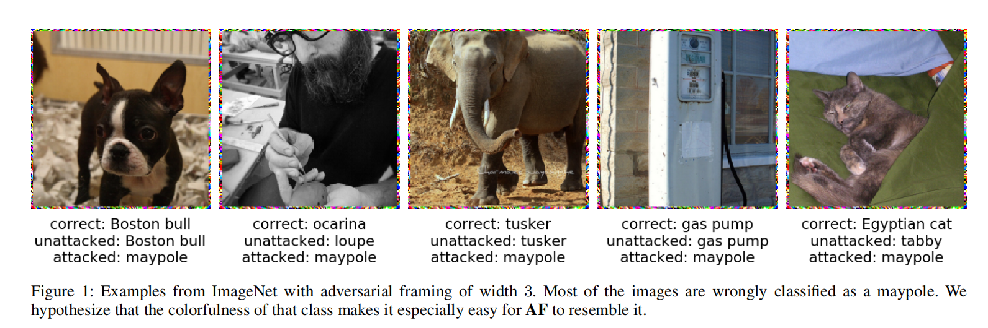
Result analysis

Slide 9
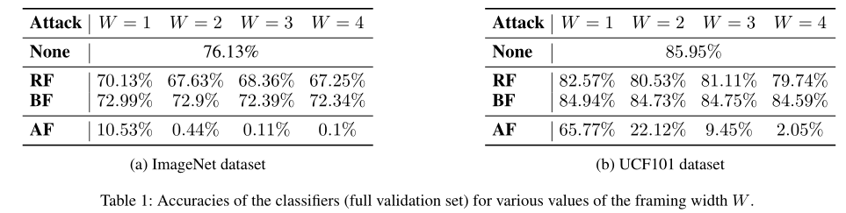
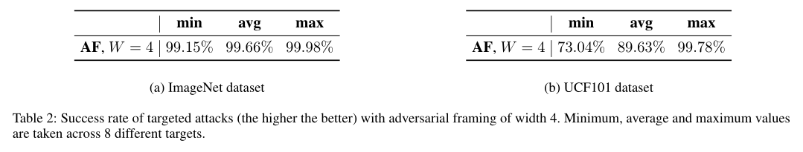
Result analysis
1.Introducing uniformly distributed random noise (RF) and black pixels (BF) and AF confrontation framework for horizontal comparison. Both RF and BF can make the classification accuracy of the classifier slightly lower, but AF can significantly reduce the classification accuracy of the classifier
2.For the AF confrontation frame, the larger the W (width), the better the effect.
3.When W=4, the success rate of misleading the target category is extremely high, with pictures up to 99.98% and videos up to 99.78%

Slide 10
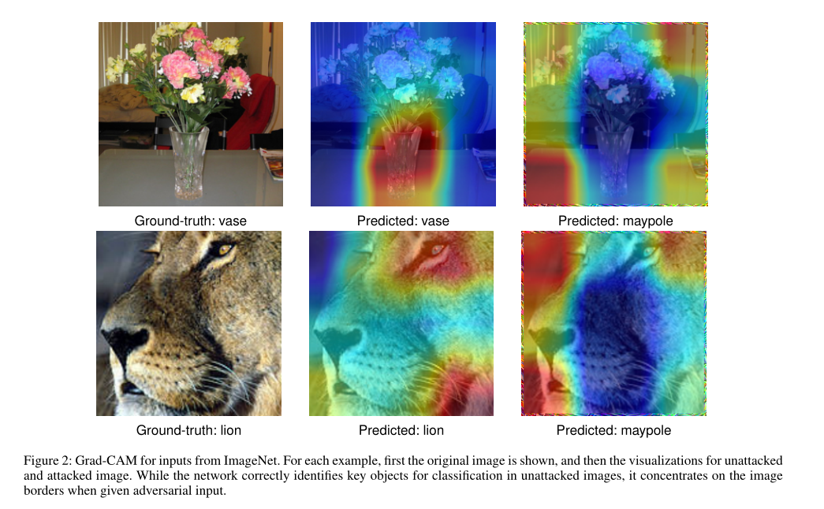
Grad-CAM
GradCAM(Selvarajuetal.2017)is a method for producing visual explanations for a convolutional neuralnet work’s predictions
For a given classiﬁer f,input x and a class c,it computes a heatmap visualizing how much particular regions of x contribute to a score of the class c output by f.

Slide 11
Conclusion
Advantage
The method does not modify the original content of the input
only adds a small border to surround it
The proposed attack is universal (i.e. the same adversarial framing can be applied in different images or videos)
While the network correctly identifies key objects for classification in unattacked images, it concentrates on the image borders when given adversarial input
Disadvantage
Although the increase in the border has an obvious effect on the classifier, it will be recognized if there is manual sampling recognition
Application scenario:
Audio and video transmission that avoids sensitive detection (fidelity)
Human machine recognition

